Slide 1
DFW Analysis Results
NREL Team
National Renewable Energy Lab
Notes:
Hello. I'm Monte Lunacek
Caleb Phillips, PI
Our vision is to provide “Wisdom to guide mobility transformations as US ports”
This is a picture of the Athena team at our annual meeting at Oakridge National Lab in 2019.

Slide 2
Overview
Data collected
Extreme events
Algorithms and methodology
COVID monthly analysis results
Weather events hourly analysis results
Airport similarity
Algorithms and methodology
Results
Runway analysis
Discussion

Slide 3
Data Collection
DFW data
National data
Data not used and future thoughts

Slide 4
DFW Data Collected
Snowflake
Control plaza traffic data
Bus ridership
TSA information
Sales at the airport (daily and monthly)
Casper
Flight data
Noise complaints
Harris
Flights
Noise
Spreadsheets
Gas and electric usage
NOAA
High resolution rapid refresh weather data.

Slide 5
National Data Collected
Bureau of Transportation Statistics (BTS)
Airport on-time flight data

Slide 6
Data not collected or used
Airline load: Less than 1 year of data was is available from American Airlines. We could estimate this with other information, but it would take more time.
Bus ridership data: The bus ridership data in the SPOT system seemed incomplete compared to what we used with Athena previously. We did not investigate this issue. Used bus data from snowflake.
Runway temperatures:
Utility data from Snowflake: This would be excellent to have for ongoing analysis.
NASA flight data: We received 1 year of DFW data. We could strengthen these results if we had a longer history.

Slide 7
Thoughts on data collection
DFW collects a wealth of information.
Working on a system for making this aggregate information easily available and automatically updated would enable:
Efficient analysis
Dashboard key performance indicators
Our scrapers could be a start to a daily system for updates
Doing data collection is slow and involves lots of communication. Doing this first over a longer time horizon would allow more data to be incorporated in the analysis.

Slide 8
COVID Analysis
Passenger counts, flight counts, traffic
Electric, gas, water
Noise and complaints
Retail sales

Slide 9
Algorithms and methods
We used Facebook’s Prophet timeseries forecasting to identify statistically normal bounds around a particular stream of data.
We then use this to identify anomalies.
Because COVID is so disruptive, we only trained on data prior to March 2020 and ran predictions for three years.

Slide 10
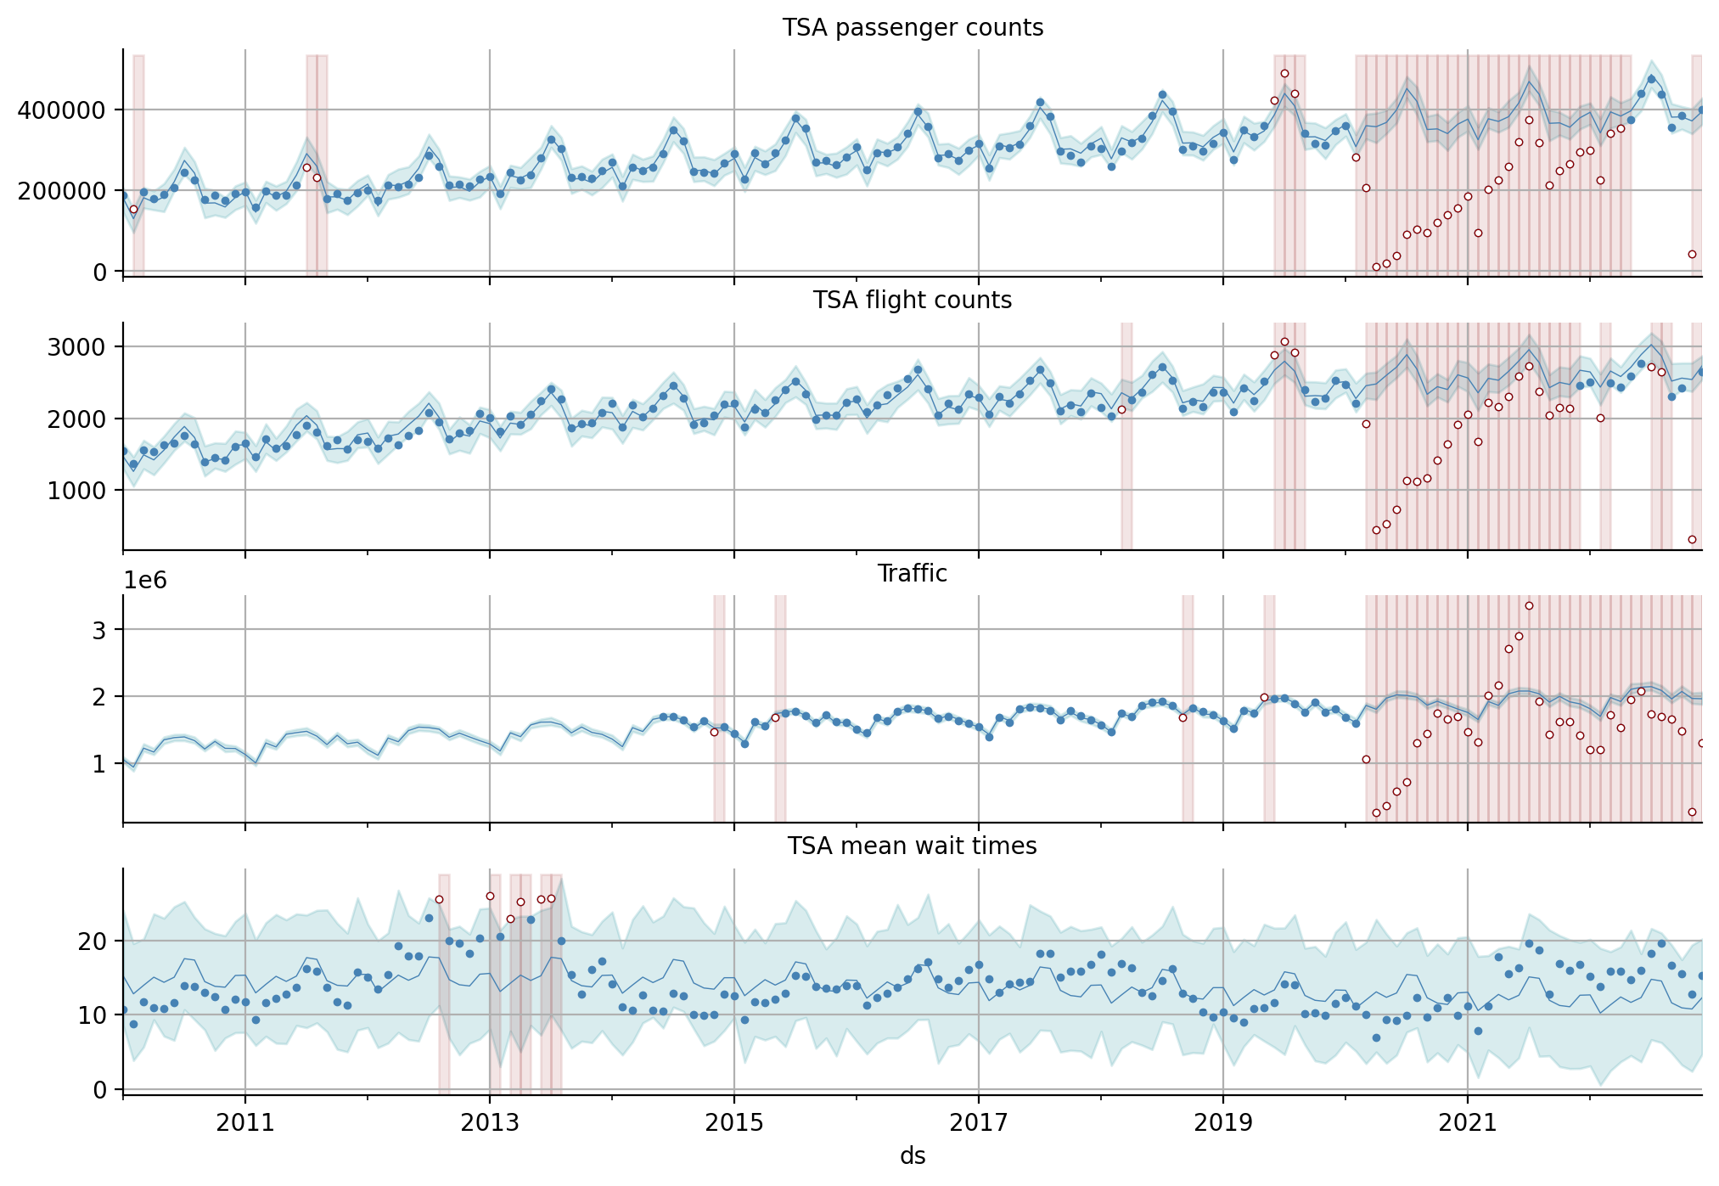

Slide 11
Passengers, Flights, Traffic, Wait times
There is a very predictable rhythm to airport operation data prior to COVID.
The uncertainty bounds are tight, and the seasonality is very predictable.
The TSA passenger and flight counts have returned to expected operational levels.
Traffic data is still statistically lower than expected.

Slide 12
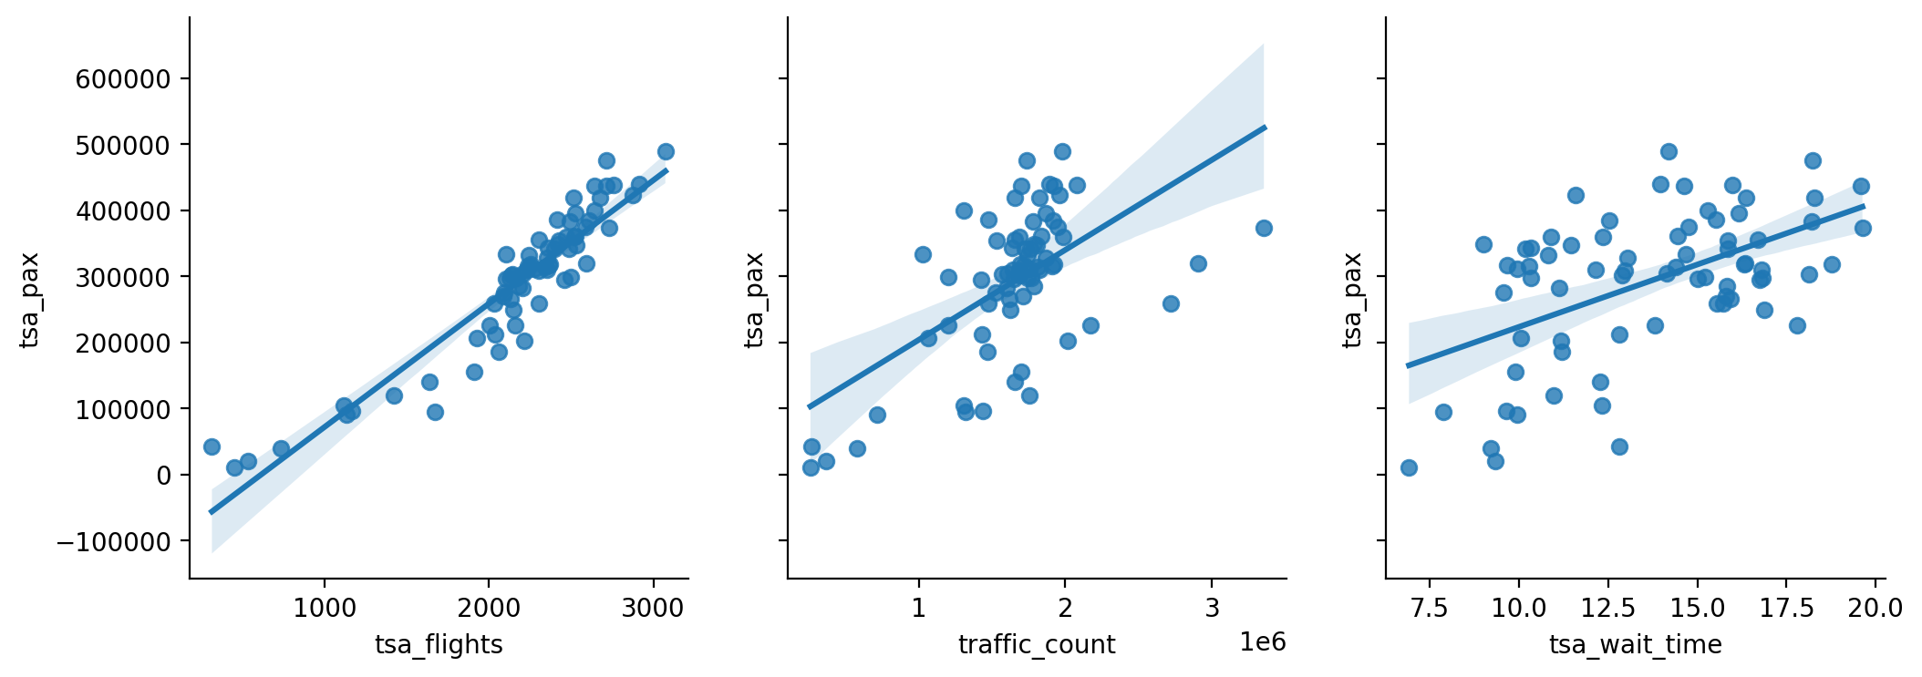

Slide 13
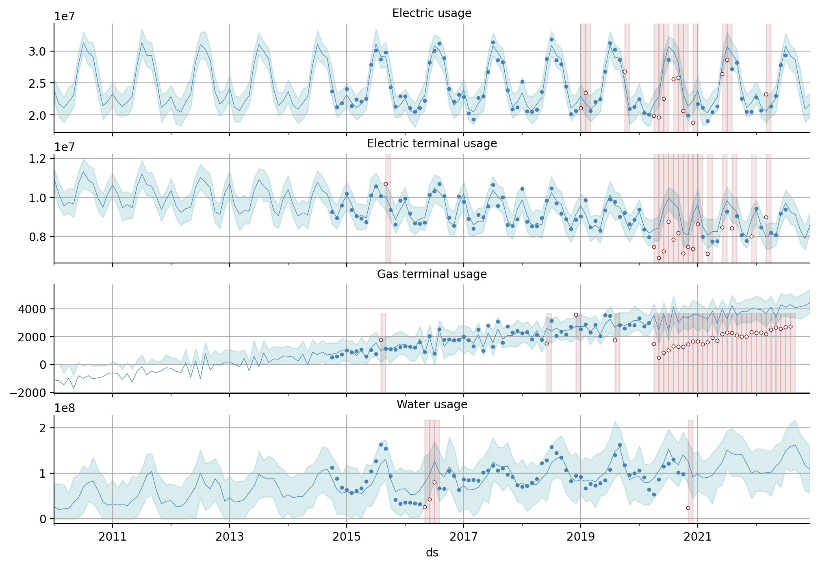

Slide 14
Utility discussion
The electric usage at DFW is not strongly correlated with the passenger and flight operations.
Electricity in the terminals has decreased while gas usage has increased.
Water usage appears to be in normal ranges for the data we have.

Slide 15
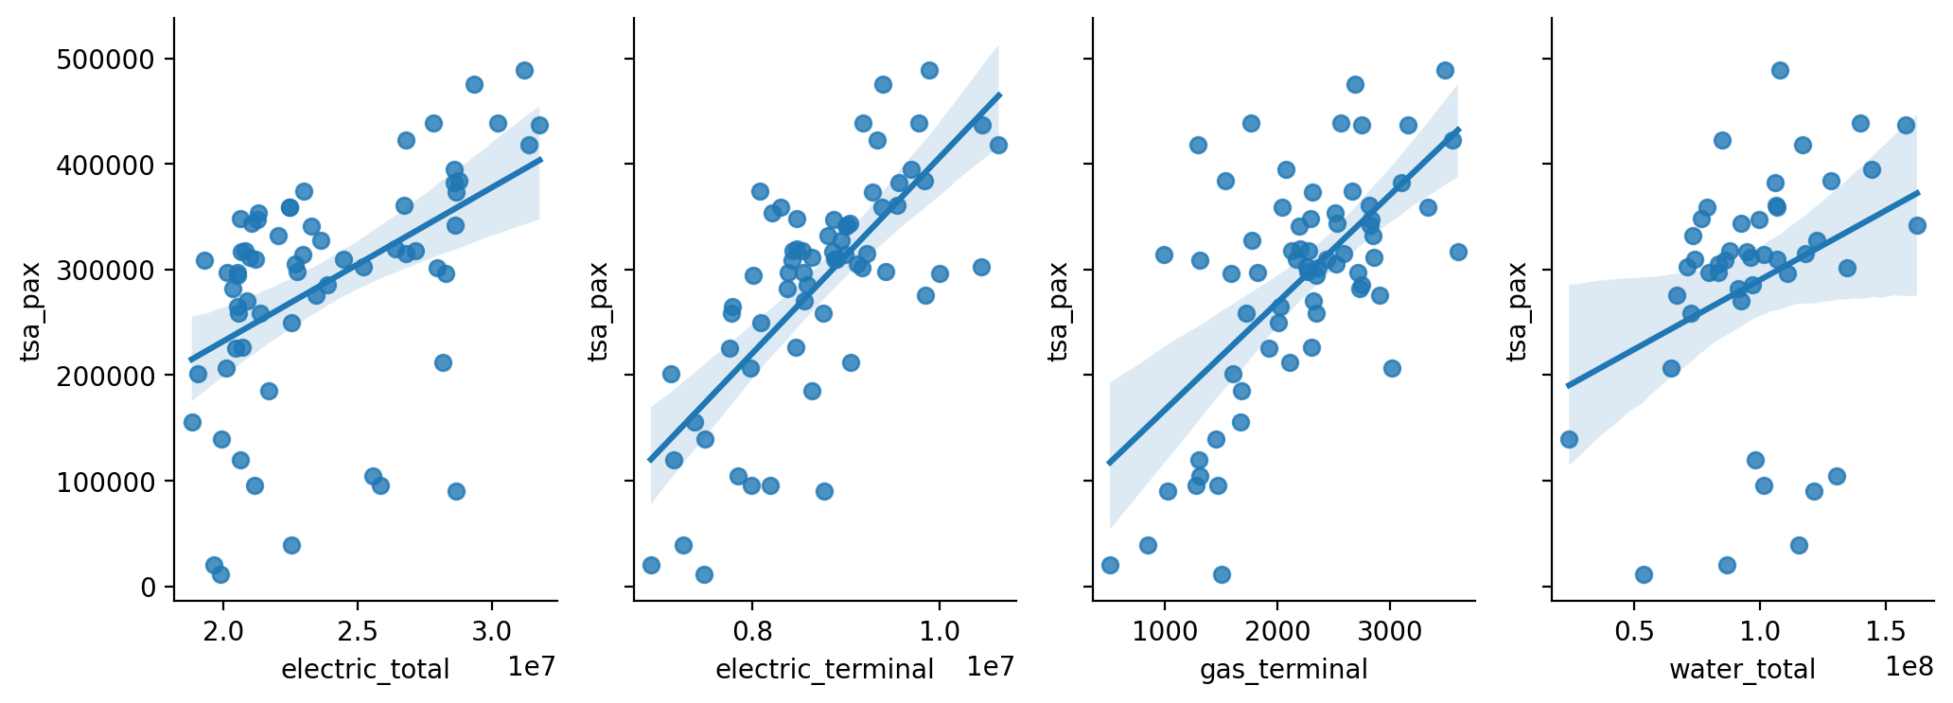

Slide 16
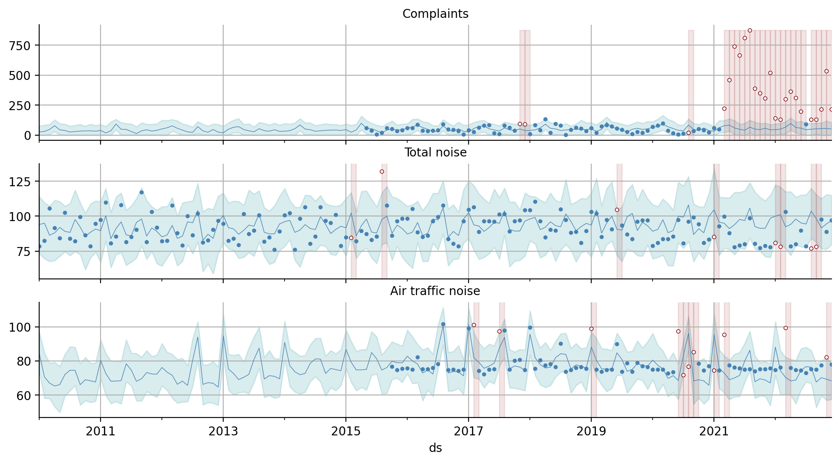

Slide 17
Noise and complaints
The total noise from DFW was within normal ranges for the entire period of data we analyzed.
Aggregate noise due to air traffic was lower at times after COVID.
Complaints were statistically much higher COVID despite consistent overall noise and normal or lower noise from air traffic.

Slide 18
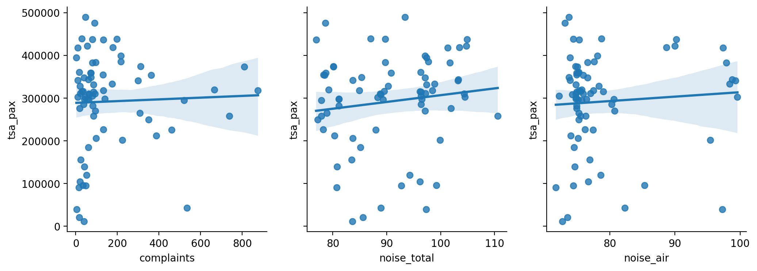

Slide 19
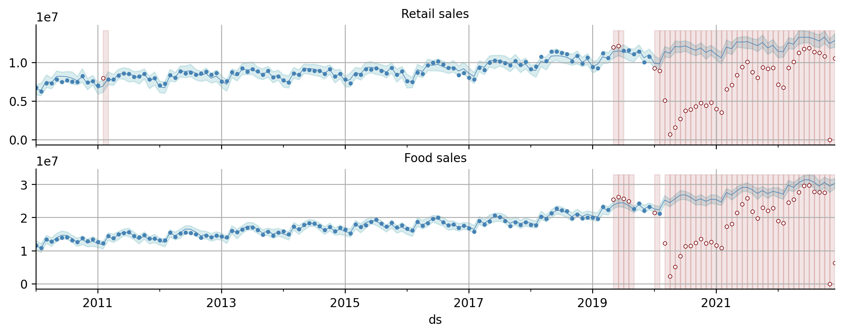

Slide 20
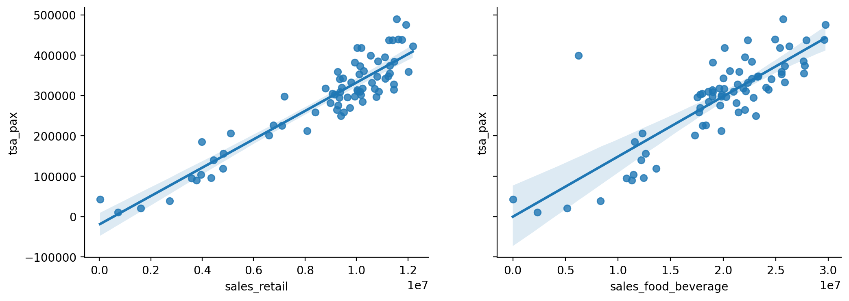
Retail and food sales
Both retail and food sales are correlated with TSA passenger information.
Both streams have almost recovered to their predicted volumes.

Slide 21
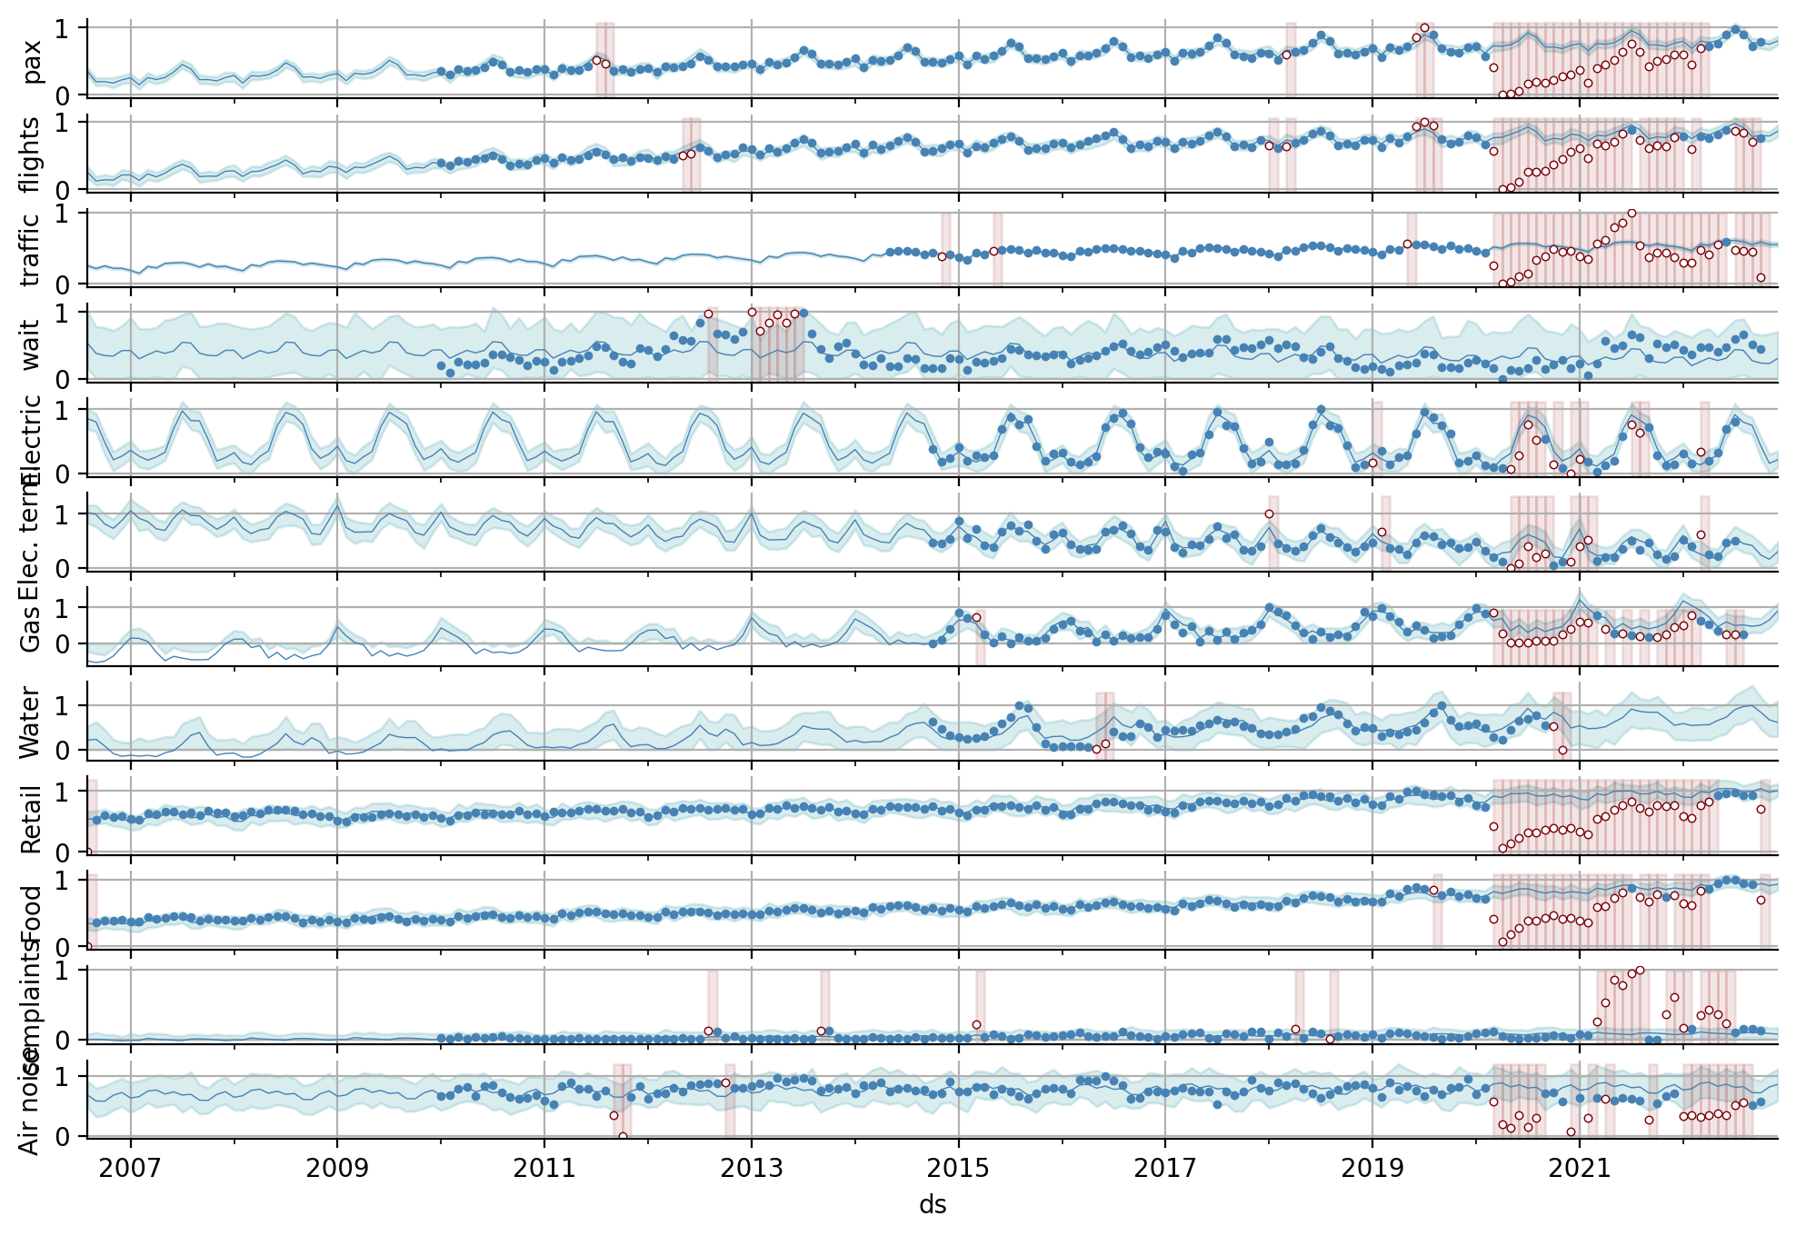

Slide 22
Weather Analysis

Slide 23
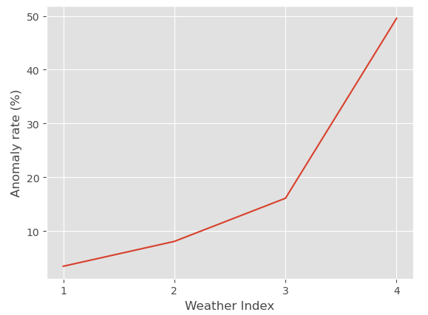
Weather KPI
Output 1 (weather index):
Grade 1: <5% anomaly rate
Grade 2: 5-15%
Grade 3: ~20%
Grade 4: ~50%
Output 2 (Type of interference):
Low visibility
Snow
Ice rain
Rainstorm
84% rainstorm
16% frozen rain
26% snow
40% rainstorm
19% frozen rain
15% low visibility
39% heavy snow
12% heavy frozen rain
49% both heavy snow and frozen rain

Slide 24
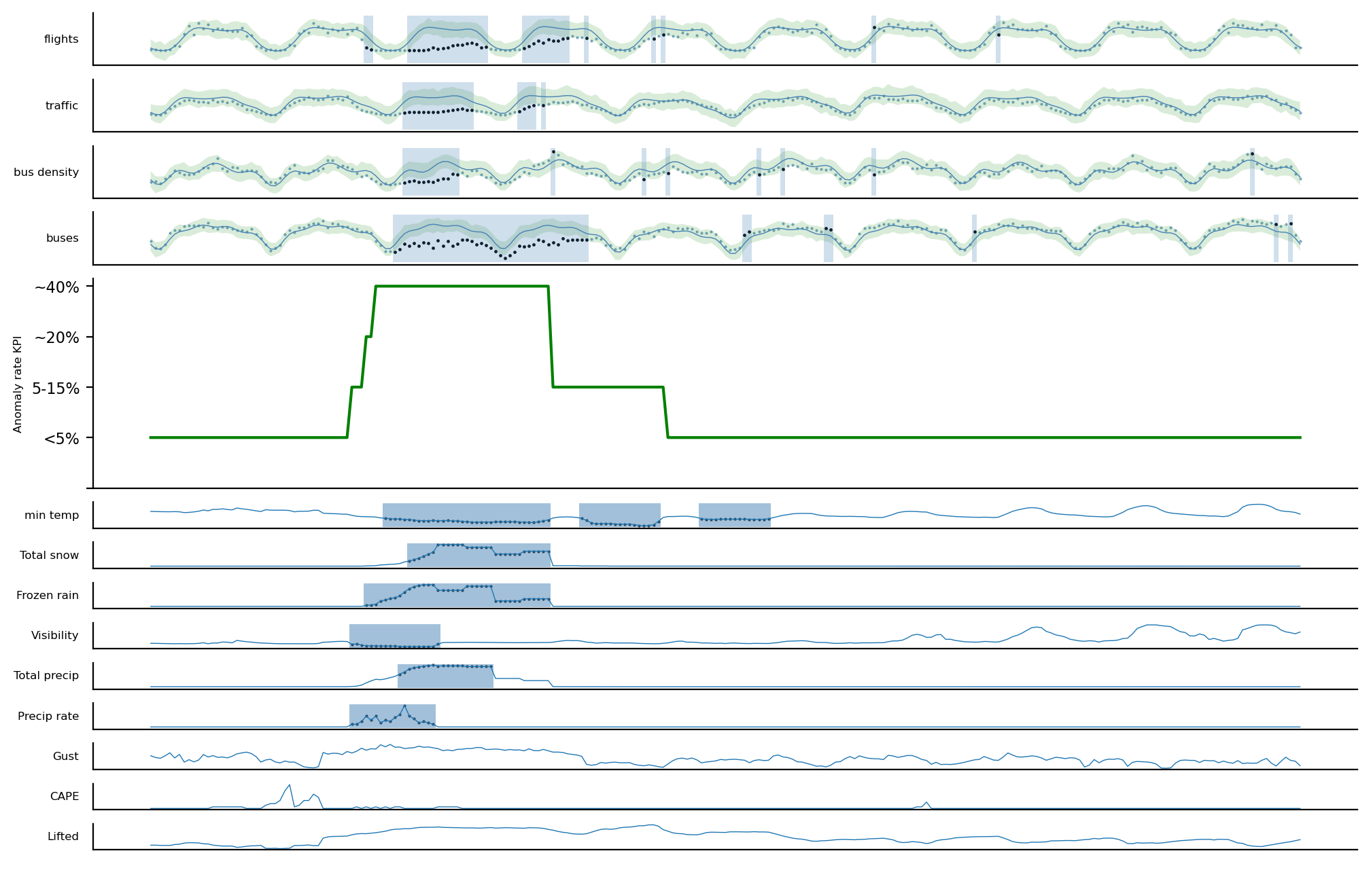
"2022-02-03"

Slide 25
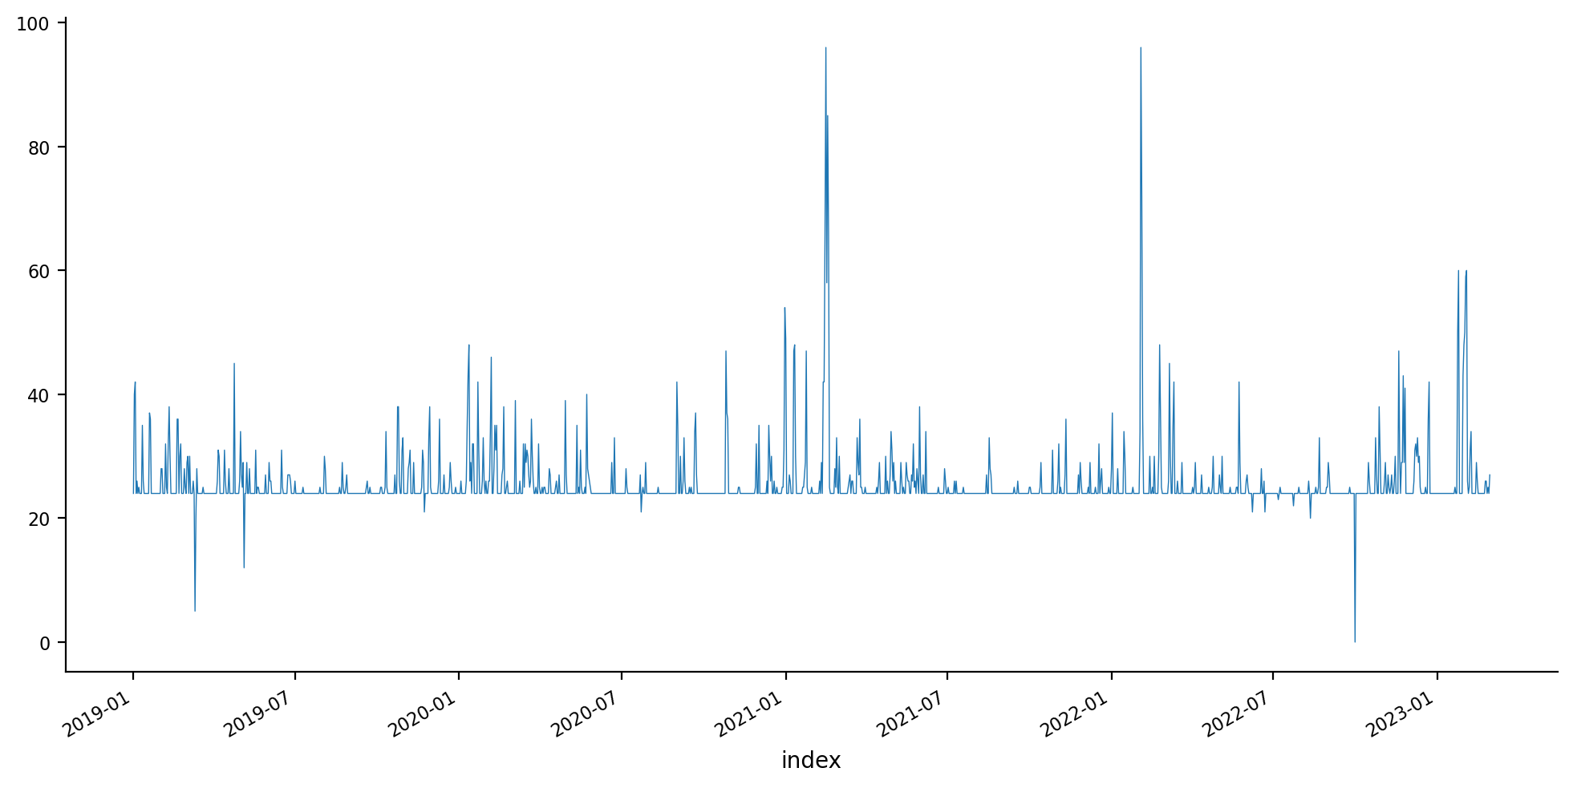
Other dates
2021-02-15
2022-02-03
2023-02-03

Slide 26
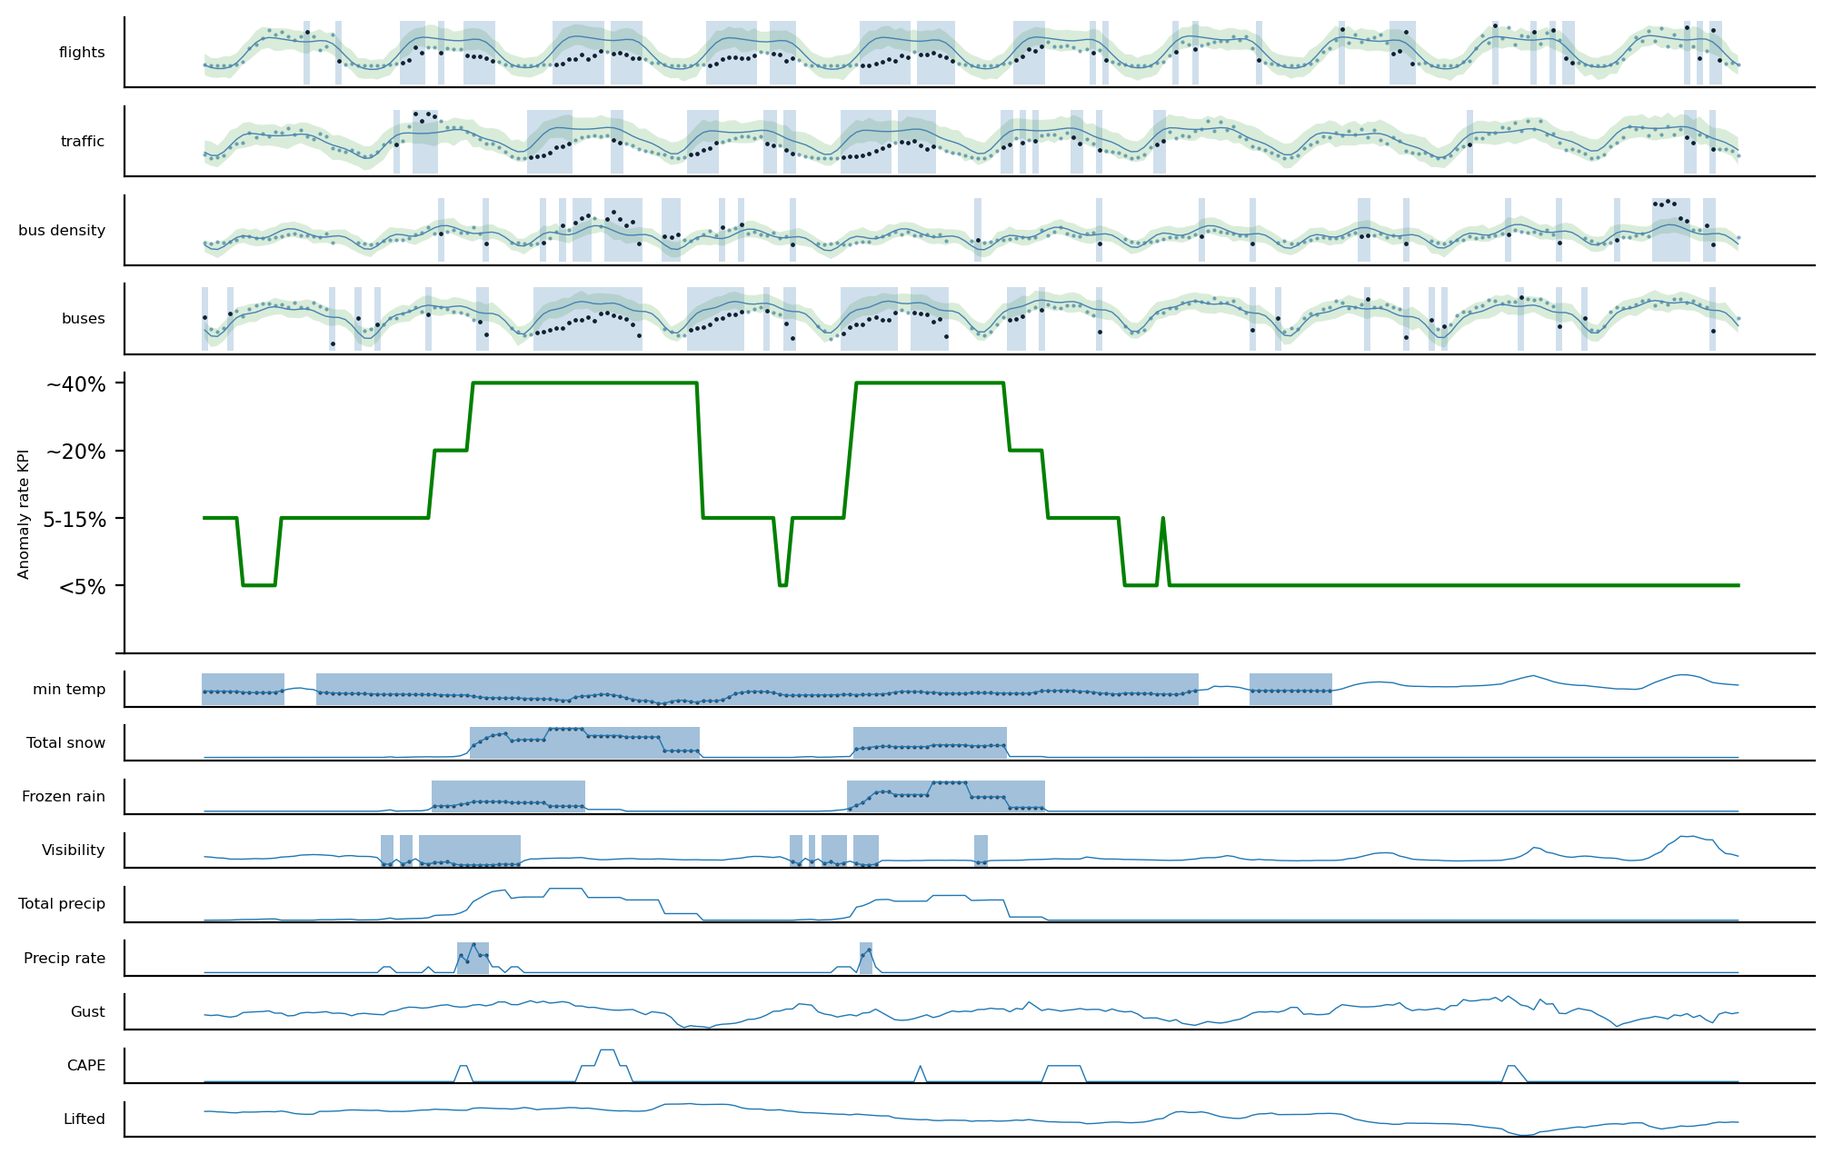
"2021-02-15"
"2021-02-17"

Slide 27
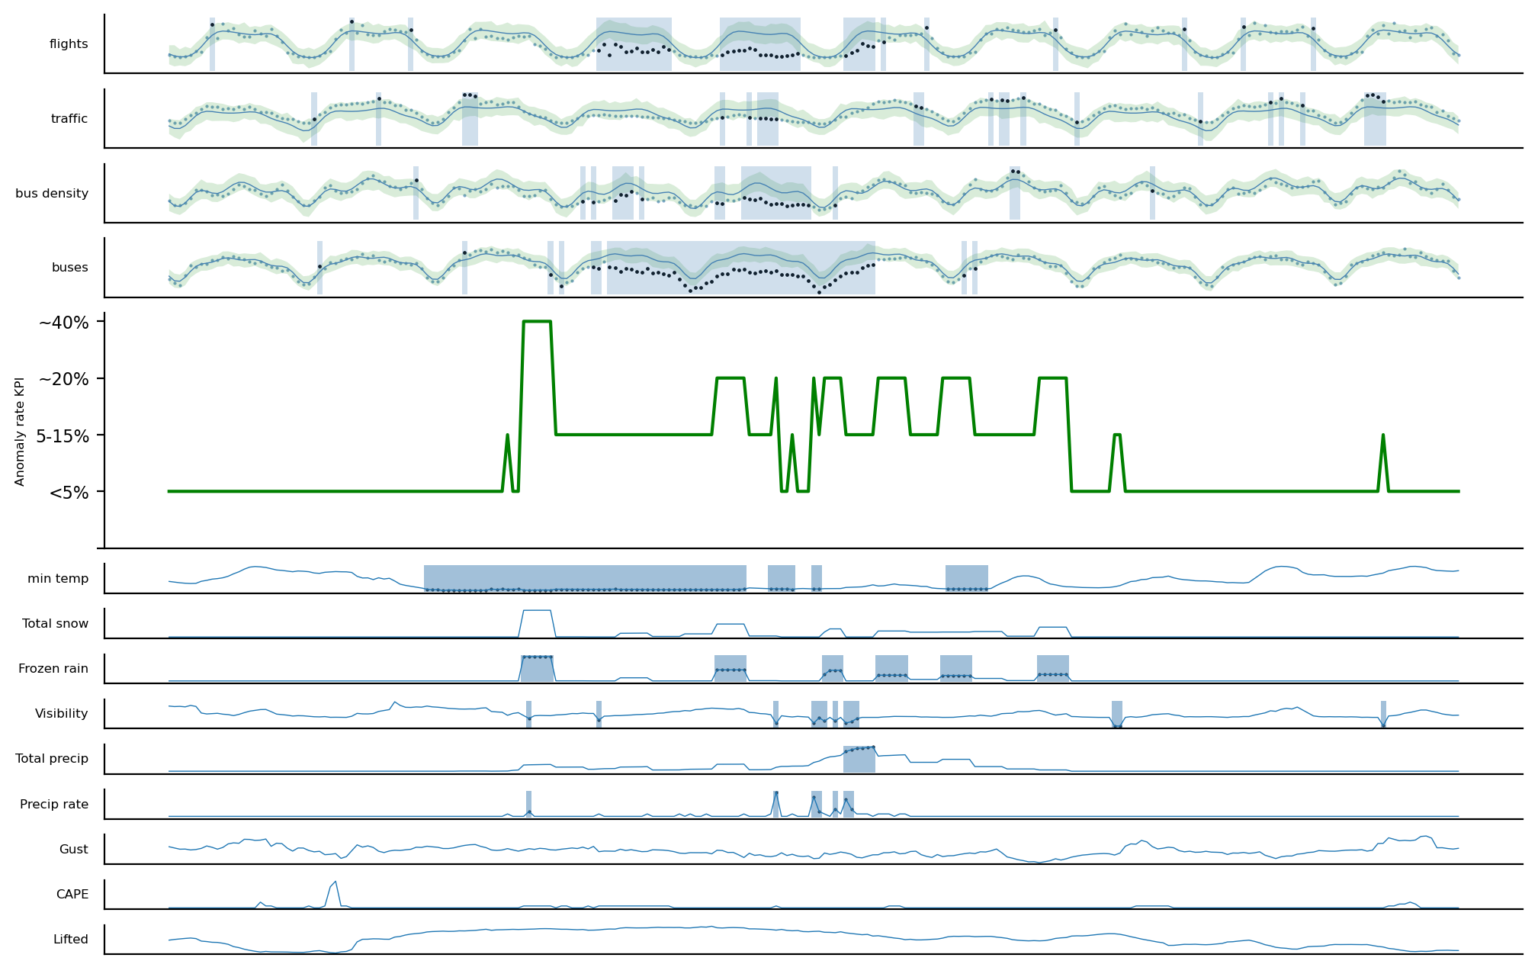
2023-02-03

Slide 28
Airport Clustering

Slide 29
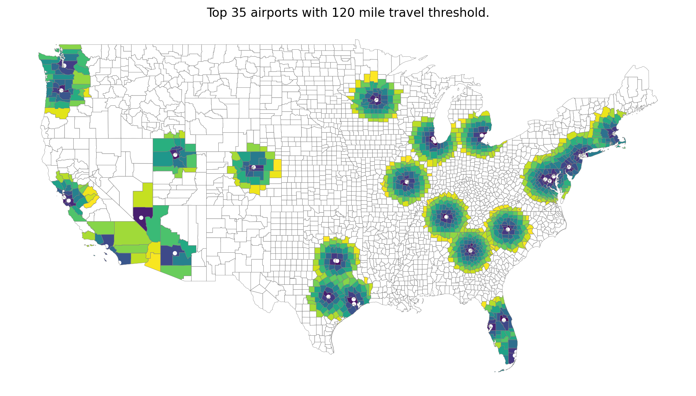

Slide 30
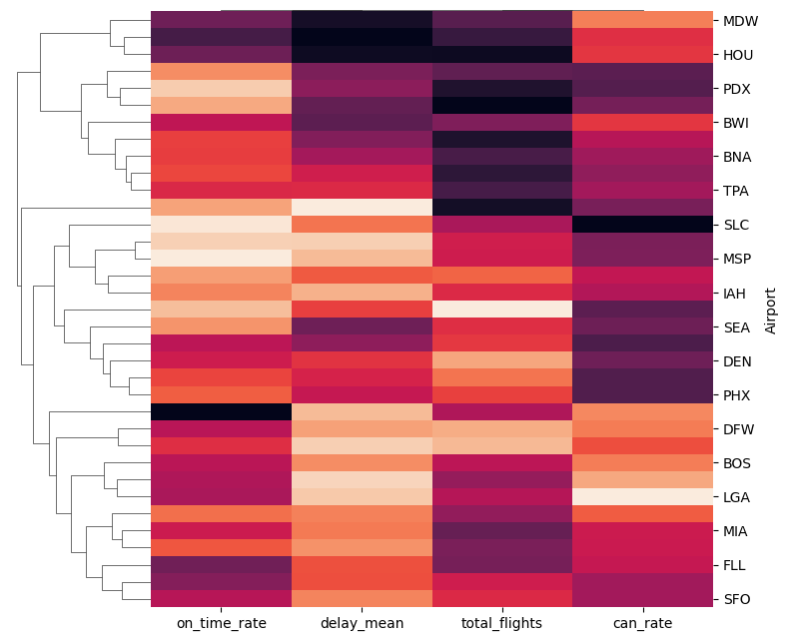

Slide 31
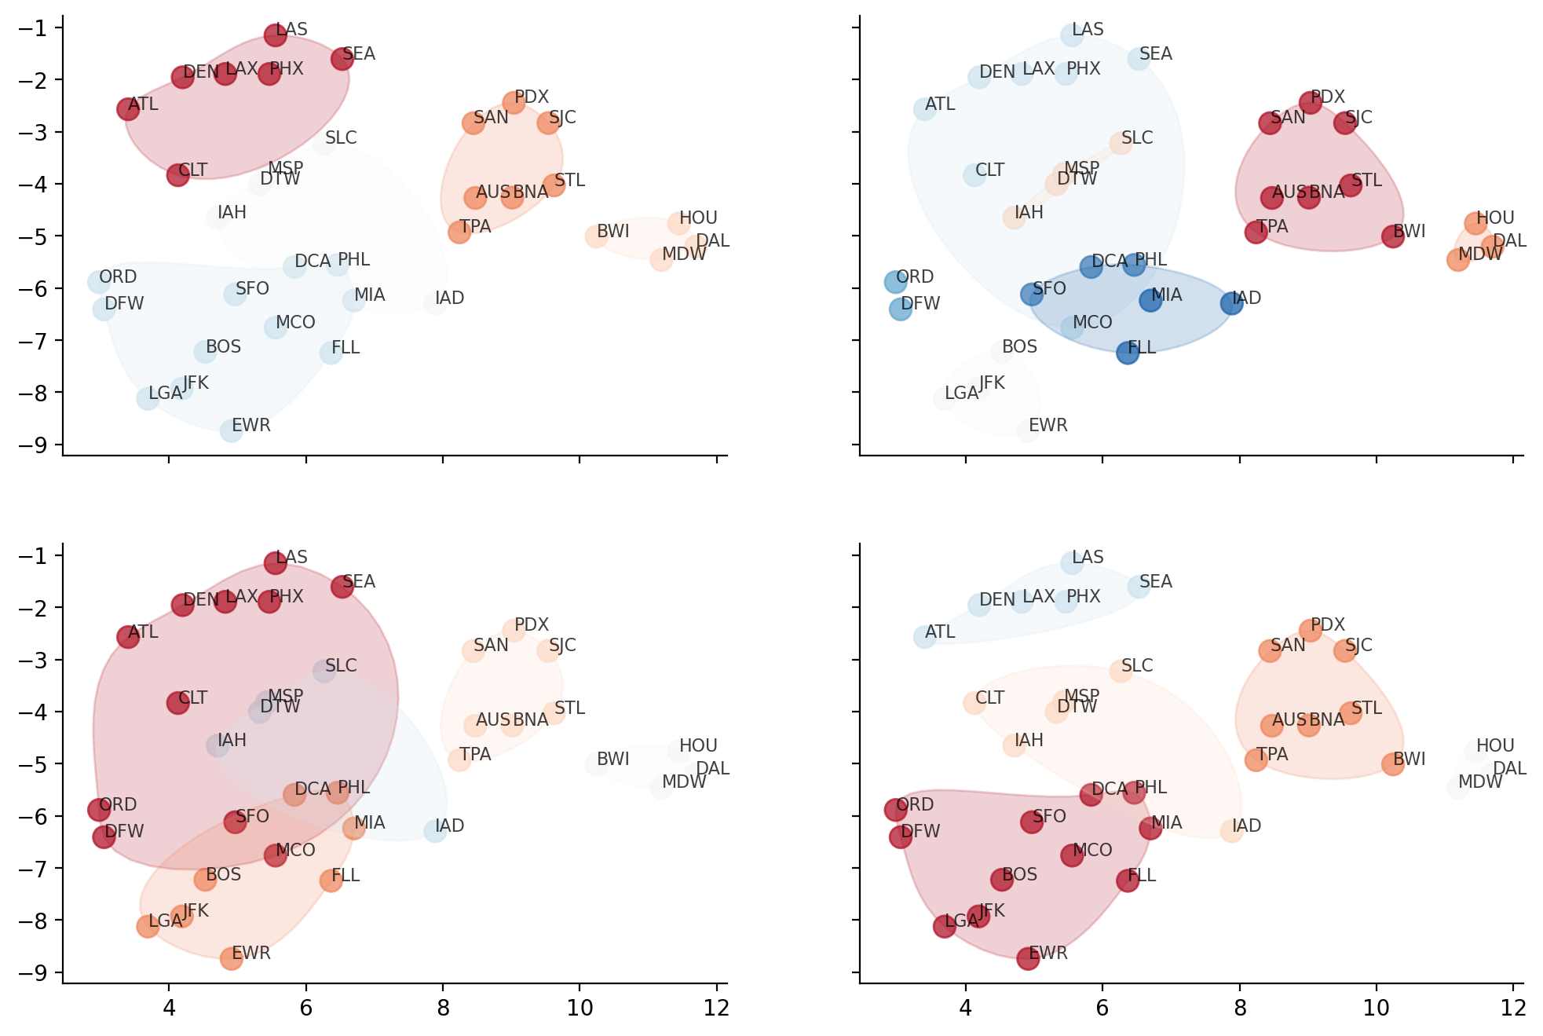

Slide 32
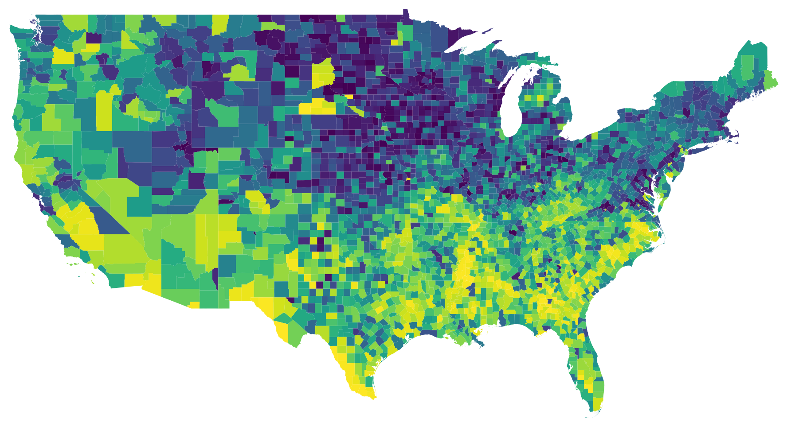
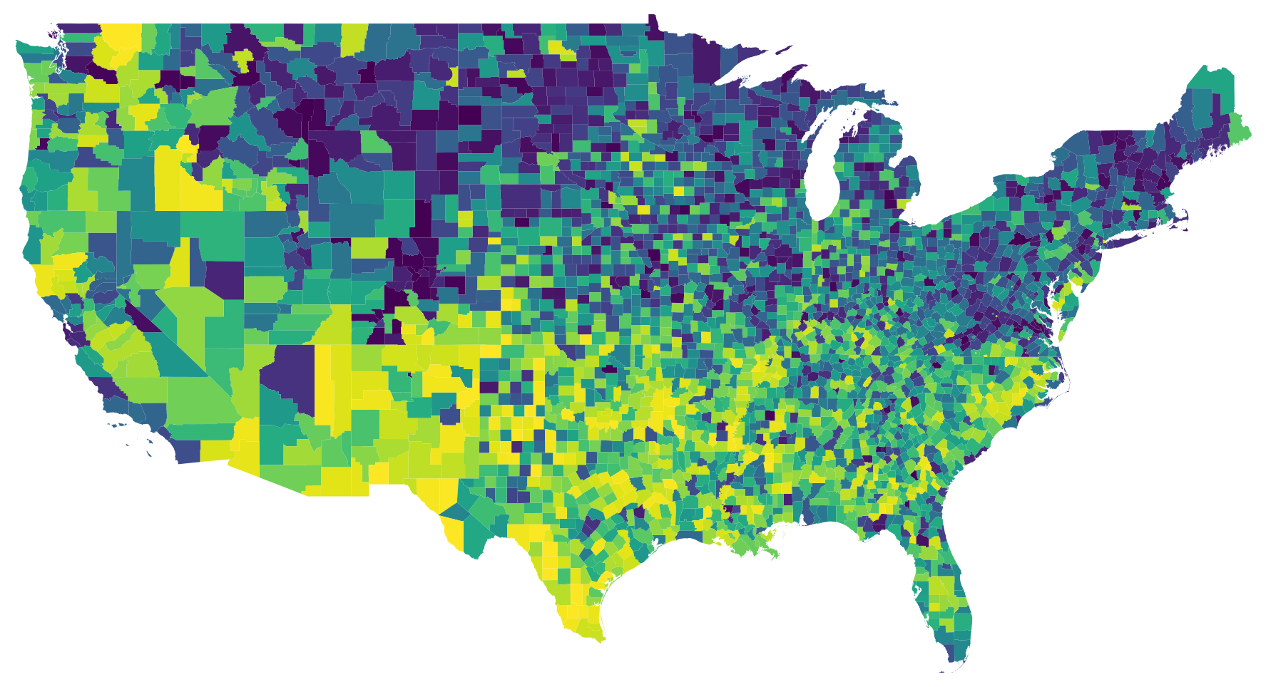
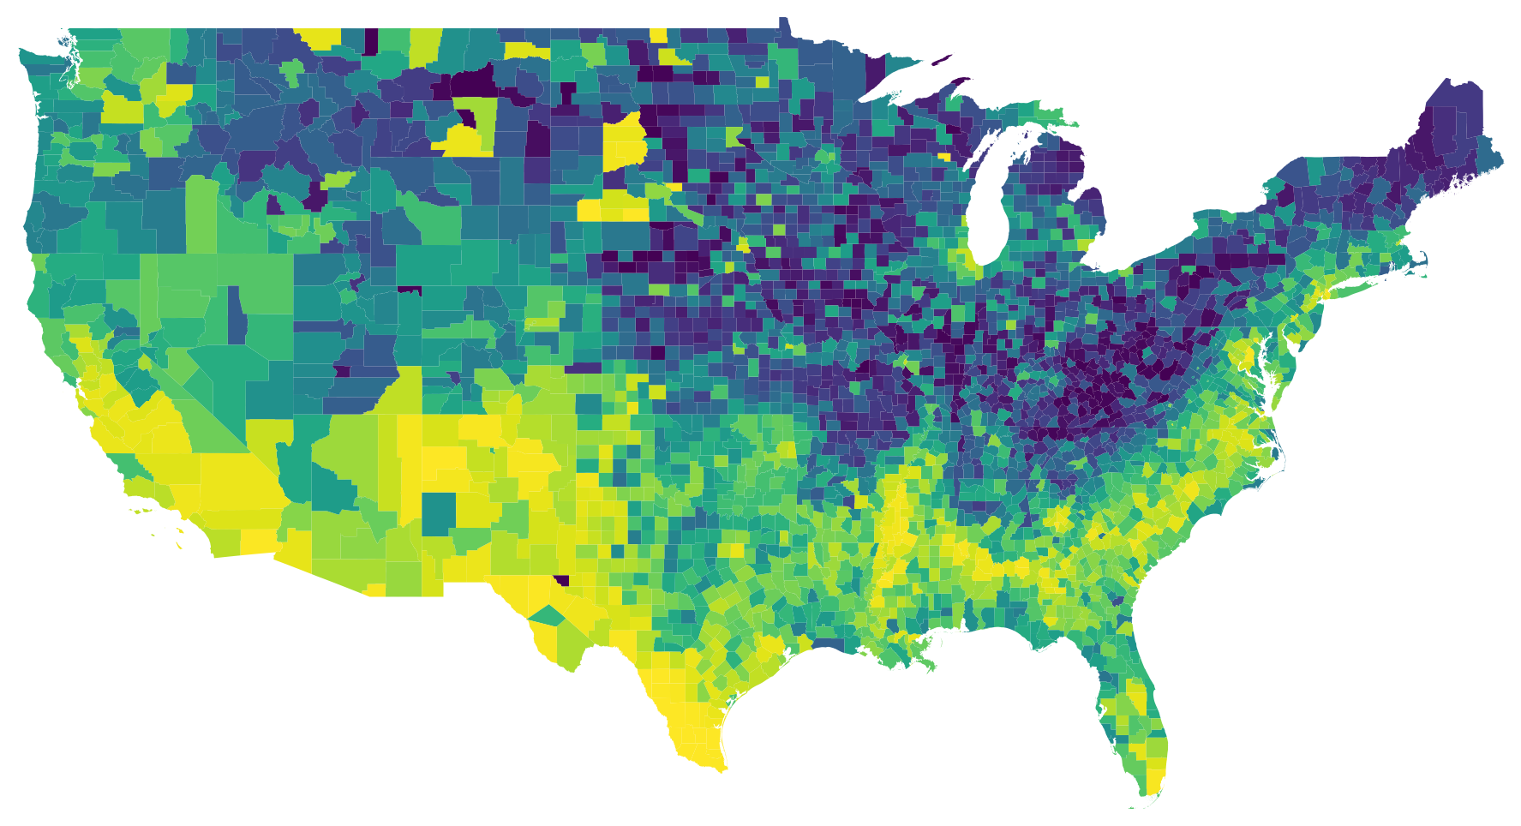
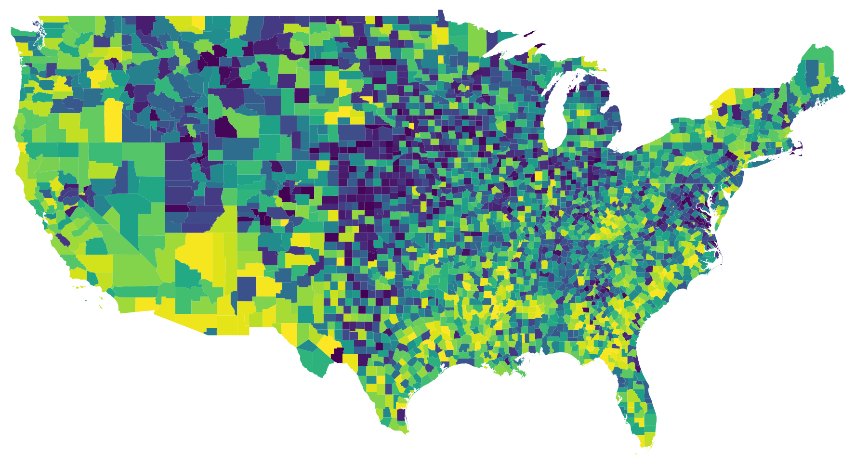
CDC Social Vulnerability

Slide 33
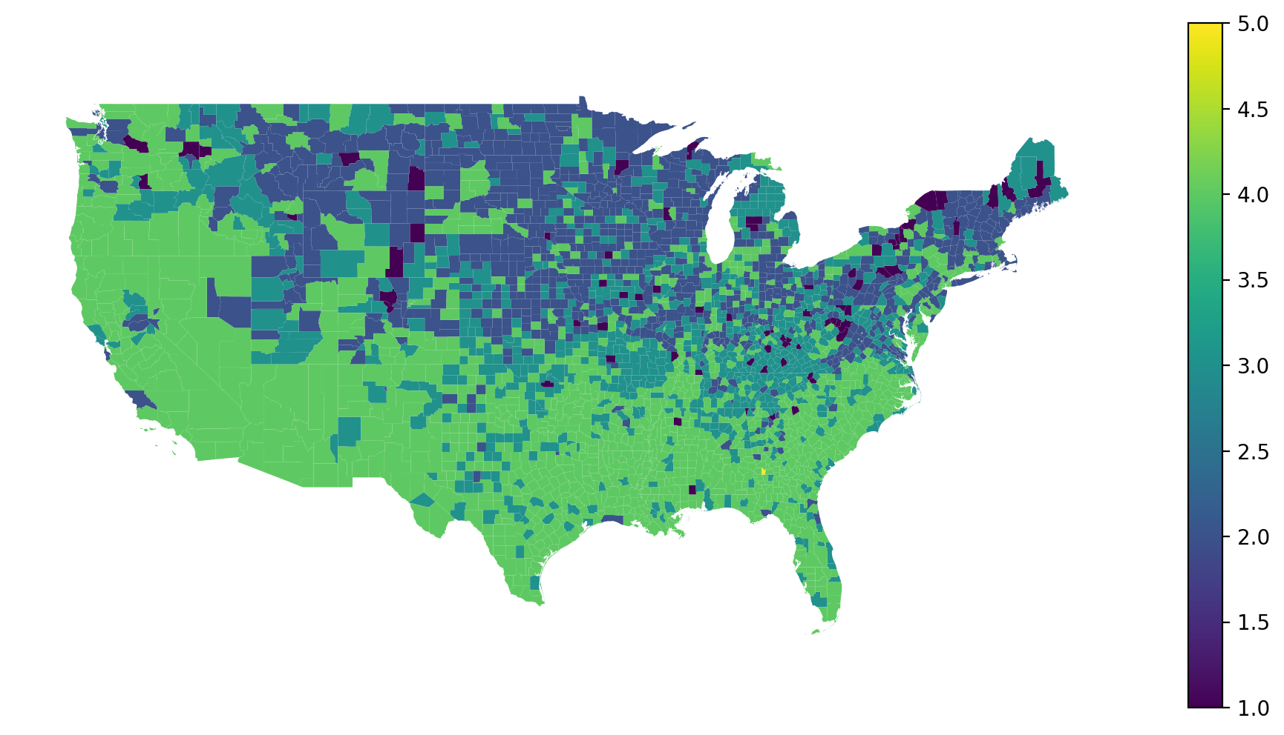

Slide 34
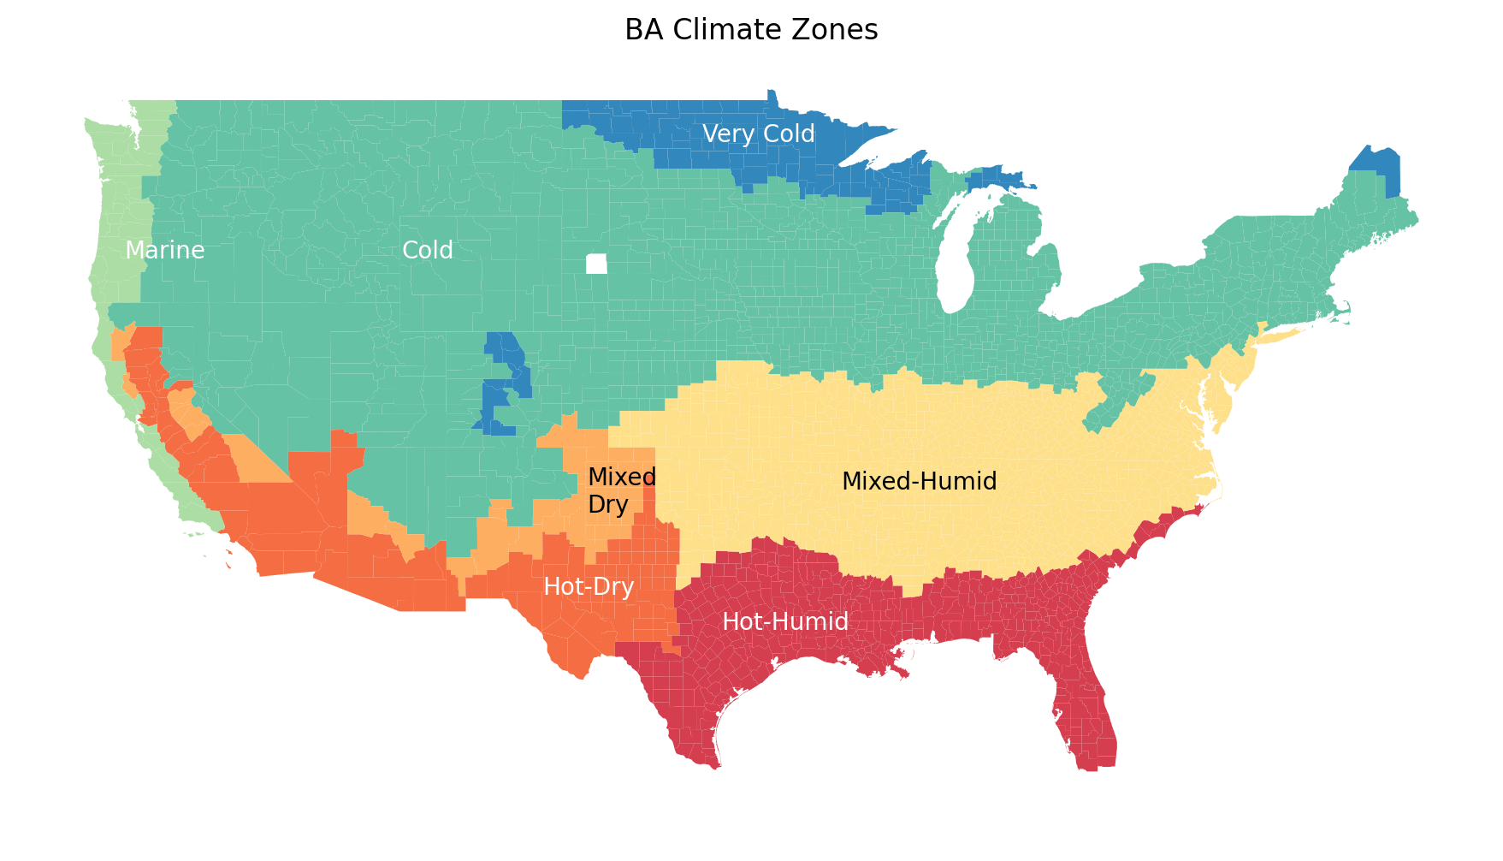

Slide 35
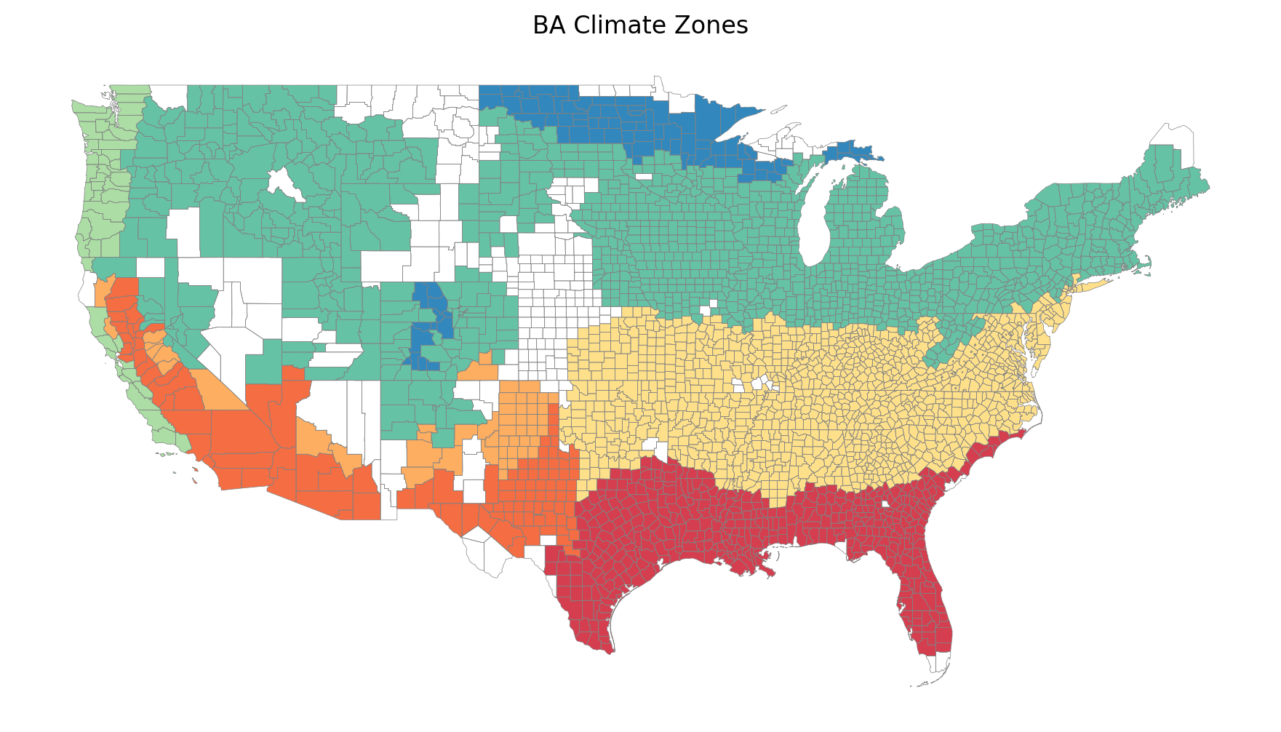

Slide 36
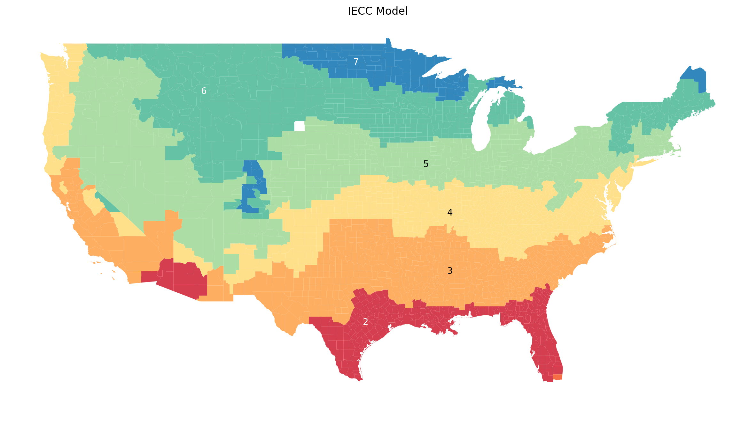

Slide 37
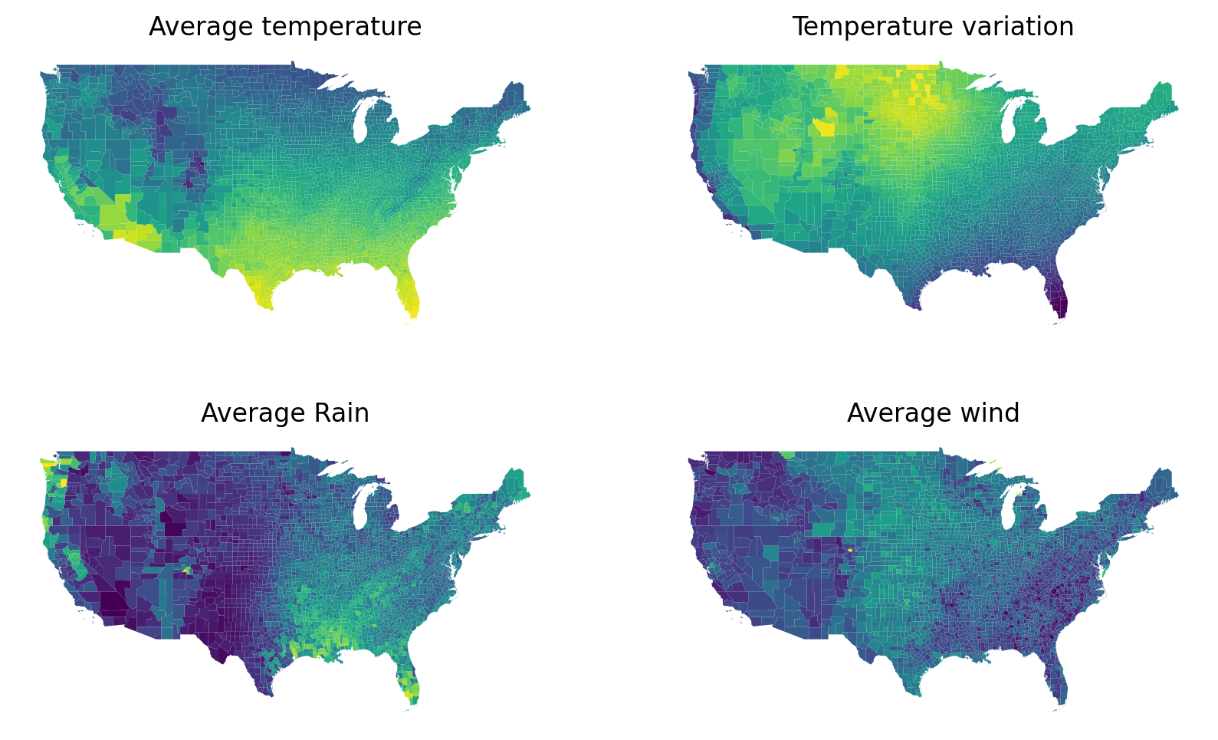

Slide 38
Runway analysis

